Slide 1

Restaurant Finder
Rahul Lachhani-121070035 (T.Y.B.Tech. Computer)
Mohit Gurnani-121080002 (T.Y.B.Tech. I.T.)

Slide 2
Contents at a glimpse
Introduction
Objective
Tools/Technologies used
Features
System Development Life Cycle
Activities
Process Model
Testing strategy
Constraints
Future extensions

Slide 3
Introduction
“ We don’t eat to live, we live to eat.”
As folk’s say “We eat to live” but country like India is highly diverse when it comes to “FOOD”. This diversity has so many options that whole life is less to consume all different tastes present! This changes our thinking from “We eat to live” to “We live to eat”

Slide 4
Objective
To design a restaurant finder app which helps user choose the best place to dine nearby or elsewhere in any part of the world.
In a new place you are definitely stuck with this question ‘Where to eat?’ Just think of Taste Buds, the app helps you find restaurants near you according to your taste, your budget and based on reviews and ratings so that you don’t land up eating something that you never expected.
Provision that enables user to navigate to the desired restaurant from his current location.

Slide 5
Tools/Technologies Used
Tool: Android Development Tools(ADT)
IDE: Eclipse Juno
Databases: MySQL, SQLite
APIs: Google Places API, Google Maps API, Facebook SDK, Zxing library
Languages: Java, PHP, XML

Slide 6
Features
An “Appealing, User-friendly, Multi-functional, Data-driven App”
A focused collection of restaurants, including photos, contact information , geographical details, reviews etc.
Facility for compound filtering and sorting.
Enables user to share his experience, up-vote or down-vote, rate and recommend a restaurant.
Get a clear picture of restaurants near us using maps.
Proficiency to reserve a table in a restaurant.

Slide 7
Features Continued…
My Wishlist – Feature to store your favourite restaurants
Retrieving restaurant details by scanning QR Code and sharing restaurant information with QR Code.
Apprise ongoing offers for a restaurant.
Facility for Restaurant Manager to confirm or decline a request for table.
Reducing the overhead of collecting information like photos, menus, offers by providing update feature to Restaurant Managers

Slide 8
System Development Life Cycle
Activities performed:
Understanding and analysing requirements
Designing
Creating a design structure that organizes the logic in the system
Less prone to “ripple effect”
Direct outgrowth of modularity and the concepts of cohesion and coupling
Coding
To figure out the most suitable solution
To communicate thoughts about programming problems
Testing
To determine whether a given feature works as intended
Every piece of code tested before moving on to the next feature

Slide 9
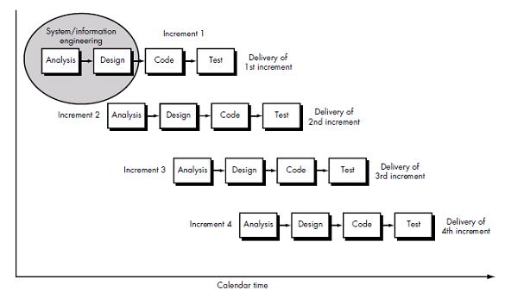
Process Model

Slide 10
Process Model Continued…
Incremental process model- a method of software development where the model is designed, implemented and tested incrementally
Major requirements defined
Entirely new development
A new feature added with each increment
Easier to test and debug than other methods of software development

Slide 11
Testing Strategy
To write the basic test cases from the available specification
Unit Testing
Each unit isolated from the remainder of the code to determine whether it behaves exactly as expected
E.g.- Verification of proper working of app in case if internet connection is not active
Expected result: User should get a prompt “No Internet Connection” and as soon as the connection is active the app should respond immediately!
Actual result: Pass

Slide 12
Testing Strategy Continued…
Integration Testing
Two units that have already been tested combined into a component
The interface between them is tested
E.g.- Verification of provision to navigate to a particular restaurant Expected result: Users must be able to get the directions of the restaurant which they are currently viewing.
Actual result: Pass

Slide 13
Constraints
Data-size related:
Only 20 nearby restaurants are loaded at one point. This is done to decrease the response time for application.
Offers:
Offers are not automated in our app. They have to be updated by the Restaurant Managers.

Slide 14
Future extensions
Admin side is now integrated in the main application which may not be a good view for user!
We need to make a separate app for admin which will be given to all the authorized restaurant owners
As of now whole work of admin side is controlled by only 1 person. This can be distributed among various persons such as content managers for more efficient functioning or application can also be automated for doing the same.

Slide 15
References
http://www.uptecnet.com/rel2/pe/ignou_workshop/projectguidelines.ppt.ppt
http://en.wikipedia.org/wiki/Incremental build model
http://www.softwaretestinghelp.com/
http://www.sqatester.com/documentation

